Slide 1
Z. Gu
Embedded Systems with ARM Cortex-M Microcontrollers in Assembly Language and C
Chapter 4
ARM Arithmetic and Logic Instructions
Fall 2026
Acknowledgement: Lecture slides based on Embedded Systems with ARM Cortex-M Microcontrollers in Assembly Language and C, University of Maine https://web.eece.maine.edu/~zhu/book/

Slide 2

Adding Two Integers
int x = 1;
int y = 2;
int z;
If values are in registers
  Value of x in r0
  Value of y in r1
  Value of z in r2
C Statement
Assembly Statement
z = x + y;

Slide 3
Adding Two Integers
int x = 1;
int y = 2;
int z;
If values are in registers
  Value of x in r0
  Value of y in r1
  Value of z in r2
C Statement
Assembly Statement
z = x + y;
r1
r0
ADD , ,
r2
Destination
Source Operand 2
Source Operand 1

Slide 4
Adding Two Integers
uint x = 1;
uint y = 2;
uint z;
If values are in registers
  Value of x in r0
  Value of y in r1
  Value of z in r2
C Statement
Assembly Statement
z = x + y;

Slide 5
Adding Two Integers
uint x = 1;
uint y = 2;
uint z;
If values are in registers
  Value of x in r0
  Value of y in r1
  Value of z in r2
C Statement
Assembly Statement
z = x + y;
r1
r0
ADD , ,
r2
ADD works for both signed and unsigned add operations.

Slide 6
Adding Two Integers
int x = 1;
int y = 2;
int z;
If addresses are in registers
  Address of x in r0
  Address of y in r1
  Address of z in r2
Assembly Statements
C Statement
z = x + y;

Slide 7
Adding Two Integers
int x = 1;
int y = 2;
int z;
If addresses are in registers
  Address of x in r0
  Address of y in r1
  Address of z in r2
Assembly Statements
C Statement
LDR r3, [r0] ; Read x
LDR r4, [r1] ; Read y
ADD r5, r3, r4
STR r5, [r2] ; Write z
z = x + y;
Load, modify, and store

Slide 8
Example Arithmetic Instructions
ADD r0, r1, r2 ; r0 = r1 + r2
ADC r0, r1, r2 ; Add with carry, r0 = r1 + r2 + carry
SUB r0, r1, r2 ; r0 = r1 - r2
SBC r0, r1, r2 ; Subtract with borrow, r0 = r1 - r2 – (1 – carry)
MUL r0, r1, r2 ; r0 = r1 * r2, product limited to 32 bits
UDIV r0, r1, r2 ; Unsigned divide, r0 = r1 / r2
SDIV r0, r1, r2 ; Signed divide, r0 = r1 / r2
SMULL r0, r1, r2, r3 ; Signed multiply (64-bit product), r1:r0 = r2 * r3
UMULL r0, r1, r2, r3 ; Unsigned multiply (64-bit product), r1:r0 = r2 * r3

Slide 9
Example Logical Instructions
AND r0, r1, r2 ; Bitwise AND, r0 = r1 AND r2
ORR r0, r1, r2 ; Bitwise OR, r0 = r1 OR r2
EOR r0, r1, r2 ; Bitwise Exclusive OR, r0 = r1 EOR r2
ORN r0, r1, r2 ; Bitwise OR NOT, r0 = r1 ORN r2
BIC r0, r1, r2 ; Bit clear, r0 = r1 & ~r2
AND r0, r1, r2
32 bits
r1
1 1 0 1 0 1 0 1 0 1 0 1 0 1 0 1 0 1 0 1 0 1 0 1 0 1 0 1 0 1 0 1
1 0 1 0 1 0 1 0 1 0 1 0 1 0 1 1 1 0 1 0 1 0 1 0 1 0 1 0 1 0 1 1
1 0 0 0 0 0 0 0 0 0 0 0 0 0 0 1 0 0 0 0 0 0 0 0 0 0 0 0 0 0 0 1
r2
r0
Bit-wise Logic AND

Slide 10





Example Shift & Rotate Instructions
LSL r0, r1, r2 ; Logical shift left,
r0 = r1 << r2
LSR r0, r1, r2 ; Logical shift right,
r0 = r1 >> r2
ASR r0, r1, r2 ; Arithmetic shift right, r0 = r1 >> r2
ROR r0, r1, r2 ; Rotate right,
r0 = r1 rotate by r2 bits
RRX r0, r1 ; Extended rotate right, {C, r0} = {C, r1} rotate right by 1 bit
Logical Shift Left (LSL)
Logical Shift Right (LSR)
Arithmetic Shift Right (ASR)
Rotate Right (ROR)
Rotate Right Extended (RRX)

Slide 11
Example Data Transfer Instructions
MOV r0, r1 ; Move, r0 = r1
MVN r0, r1 ; Move NOT, r0 = bitwise NOT r1
MVN r0, r1
r1
0 0 0 0 0 0 0 0 0 0 0 0 0 0 0 0 0 0 0 0 0 0 0 0 0 0 0 0 1 1 1 1
r0
1 1 1 1 1 1 1 1 1 1 1 1 1 1 1 1 1 1 1 1 1 1 1 1 1 1 1 1 0 0 0 0
Bit-wise Logic NOT

Slide 12
Overview:
Arithmetic and Logic Instructions
Shift : LSL (logic shift left), LSR (logic shift right), ASR (arithmetic shift right), ROR (rotate right), RRX (rotate right with extend)
Logic: AND (bitwise and), ORR (bitwise or), EOR (bitwise exclusive or), ORN (bitwise or not), MVN (move not)
Bit set/clear: BFC (bit field clear), BFI (bit field insert), BIC (bit clear), CLZ (count leading zeroes)
Bit/byte reordering: RBIT (reverse bit order in a word), REV (reverse byte order in a word), REV16 (reverse byte order in each half-word independently), REVSH (reverse byte order in the bottom half-word and sign-extend)
Addition: ADD, ADC (add with carry)
Subtraction: SUB, RSB (reverse subtract), SBC (subtract with carry)
Multiplication: MUL (multiply), MLA (multiply-accumulate), MLS (multiply-subtract), SMULL (signed long multiply), SMLAL (signed long multiply-accumulate), UMULL (unsigned long multiply), UMLAL (unsigned long multiply-accumulate)
Division: SDIV (signed), UDIV (unsigned)
Saturation: SSAT (signed), USAT (unsigned)
Sign extension: SXTB (signed), SXTH, UXTB, UXTH
Bit field extract: SBFX (signed), UBFX (unsigned)
Syntax
  <Operation>{<cond>}{S} Rd, Rn, Operand2
Notes:
BIC bit clear
ORR bit set
AND bit mask
EOR bit invert
Comparisons produce no results - just set condition codes.
CMP like SUB
CMN like ADD (subtract of a negative number is the same as add)
TST like AND
TEQ like EOR (eor of identical numbers gives result of zero)
Generally single-cycle execution (except write to PC and register-controlled shift). Mention ARM NOP & Thumb NOP.
Explain RSB and RSC which do subtract in other order (e.g. y-x not x-y)
Does not include multiply (separate instr format). No divide - compiler uses run-time library or barrel shifter to perform division.
Can combine “S” bit with conditional execution, e.g.
ADDEQS r0, r1, r2

Slide 13
Example: Add
  Unified Assembler Language (UAL) Syntax
ADD r1, r2, r3 ; r1 = r2 + r3
ADD r1, r2, #4 ; r1 = r2 + 4
  Traditional Thumb Syntax
ADD r1, r3 ; r1 = r1 + r3
ADD r1, #15 ; r1 = r1 + 15

Slide 14
Commonly Used Arithmetic Operations
ADD {Rd,} Rn, Op2 | Add Rd ← Rn + Op2
ADC {Rd,} Rn, Op2 | Add with carry Rd ← Rn + Op2 + Carry
SUB {Rd,} Rn, Op2 | Subtract Rd ← Rn - Op2
SBC {Rd,} Rn, Op2 | Subtract with carry Rd ← Rn - Op2 + Carry - 1
RSB {Rd,} Rn, Op2 | Reverse subtract Rd ← Op2 - Rn
MUL {Rd,} Rn, Rm | Multiply Rd ← (Rn × Rm)[31:0]
MLA Rd, Rn, Rm, Ra | Multiply with accumulate Rd ← (Ra + (Rn × Rm))[31:0]
MLS Rd, Rn, Rm, Ra | Multiply and subtract Rd ← (Ra – (Rn × Rm))[31:0]
SDIV {Rd,} Rn, Rm | Signed divide Rd ← Rn ÷ Rm
UDIV {Rd,} Rn, Rm | Unsigned divide Rd ← Rn ÷ Rm
SSAT Rd, #n, Rm {,shift #s} | Signed saturate
USAT Rd, #n, Rm {,shift #s} | Unsigned saturate

Slide 15
ARM Programming Model
R0
R1
R2
R3
R4
R5
R6
R7
R8
R9
R10
R11
R12
R13: Stack Pointer (SP)
R14: Link Register (LR)
R15: Program Counter (PC)
31
0
N
Z
C
V
CPSR (Current Program Status Register)
Four flag bits:
  N (negative), Z (zero), C (carry), V (overflow).
Notes:
Every arithmetic, logical, or shifting operation sets xPSR bits:

Slide 16
Program Status Register (PSR)
Application PSR (APSR), Interrupt PSR (IPSR), Execution PSR (EPSR)
31
30
29
28
27
26
25
24
23
22
21
20
19
18
17
16
15
14
13
12
11
10
9
8
7
6
5
4
3
2
1
0
APSR
N
Z
C
V
Q
Reserved
GE
Reserved
IPSR
Reserved
ISR number
EPSR
ICI/IT
T
Reserved
ICI/IT
Combine them together into one register (PSR)
PSR
N
Z
C
V
Q
ICI/IT
T
Reserved
GE
Reserved
ICI/IT
ISR number
Note:
GE flags are only available on Cortex-M4 and M7
Use PSR in code

Slide 17
NZCV Flags in xPSR
N: 1/0 = Result from ALU is Negative/positive
Z: 1/0 = Result from ALU is Zero/non-zero
C: Three cases (for unsigned arithmetic) :
  1/0 = ALU addition Carry out/no carry out
  1/0 = ALU subtraction no borrow/borrow
  1/0 = Bit shifted/rotated out
V: 1/0 = ALU oVerflowed/no overflow (for signed arithmetic)
Borrow and carry share the same flag bit.
For unsigned subtract, Borrow = NOT Carry
ALU performs the same addition whether the numbers are signed or unsigned. It just adds bits.
Afterward: C tells you about unsigned overflow. V tells you about signed overflow. Same hardware. Different interpretation.
Notes:
Same hardware. Different interpretation.

Slide 19
Updating NZCV flags in PSR
Flags not changed |  | Flags updated
ADD | ⟶ | ADDS
SUB | ⟶ | SUBS
MUL | ⟶ | MULS
EOR | ⟶ | EORS
AND | ⟶ | ANDS
ORR | ⟶ | ORRS
LSL | ⟶ | LSLS
MOV | ⟶ | MOVS
CMP r1, r2 vs SUBS r0, r1, r2
Some instructions update NZCV flags even if no S is specified.
CMP: Compare, like SUBS but without destination register
CMN: Compare Negative, like ADDS but without destination register
TST: Test, like ANDS but without destination register
TEQ: Test equivalence, like EORS but without destination register
Most instructions update NZCV flags
only if S suffix is present

Slide 20
ADD vs ADDS
ADD r0, r1, r2 ; r0 = r1 + r2, NZCV flags unchanged
ADDS r0, r1, r2 ; r0 = r1 + r2, NZCV flags updated
ADD does not update flags
ADDS updates flags
  xPSR.N = bit 31 of result (N = 1 indicates result is negative, vice versa.)
  xPSR.Z = IsZero(result)
  xPSR.C = carry, assuming r1 and r2 representing unsigned integers
  xPSR.V = overflow, assuming r1 and r2 representing signed integers

Slide 21
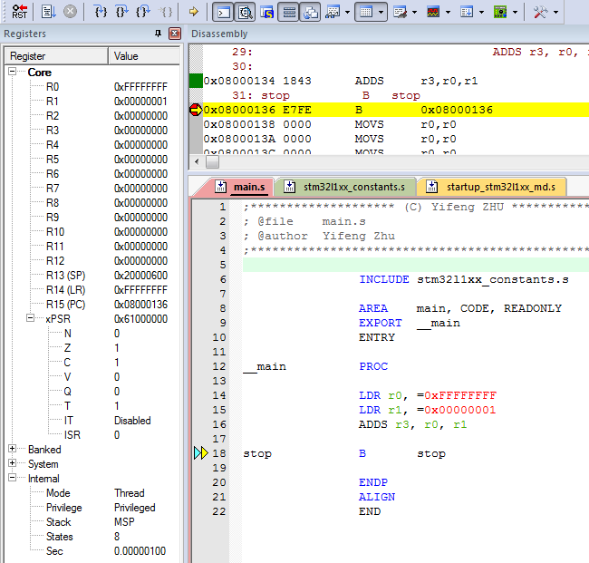
Suffix S:
Update Flags
LDR r0, =0xFFFFFFFF
LDR r1, =0x00000001
ADDS r0, r0, r1
0xFFFFFFFF r0
+
0x00000001 r1
0x00000000 sum
N (Negative) = 0
Z (Zero) = 1
C (Carry) = 1
V (oVerflow) = 0
Notes:
Combined Program Status Register (xPSR)

Slide 22
Example: 64-bit Addition
Most-significant (Upper) 32 bits
Least-significant (Lower) 32 bits
0 0 0 0 0 0 0 2 F F F F F F F F
0 0 0 0 0 0 0 4 0 0 0 0 0 0 0 1
0 0 0 0 0 0 0 7 0 0 0 0 0 0 0 0
+
Carry out
A register can only store 32 bits
A 64-bit integer needs two registers
Split 64-bit addition into two 32-bit additions

Slide 23
Example: 64-bit Addition
start
; C = A + B
; Two 64-bit integers A (r1,r0) and B (r3,r2).
; Result C (r5, r4)
; A = 00000002FFFFFFFF
; B = 0000000400000001
LDR r0, =0xFFFFFFFF ; A’s lower 32 bits
LDR r1, =0x00000002 ; A’s upper 32 bits
LDR r2, =0x00000001 ; B’s lower 32 bits
LDR r3, =0x00000004 ; B’s upper 32 bits
; Add A to B
ADDS r4, r2, r0 ; C[31..0] = A[31..0] + B[31..0], update Carry
ADC r5, r3, r1 ; C[63..32] = A[63..32] + B[63..32] + Carry, consume Carry
stop B stop
Upper 32 bits
Lower 32 bits
r1
r0
Addend1
r3
r2
Addend2
r5
r4
Sum
Carry out

Slide 24
Example: 64-bit Subtraction
start
; C = A - B
; Two 64-bit integers A (r1,r0) and B (r3,r2).
; Result C (r5, r4)
; A = 00000002FFFFFFFF
; B = 0000000400000001
LDR r0, =0xFFFFFFFF ; A’s lower 32 bits
LDR r1, =0x00000002 ; A’s upper 32 bits
LDR r2, =0x00000001 ; B’s lower 32 bits
LDR r3, =0x00000004 ; B’s upper 32 bits
; Subtract B from A
SUBS r4, r0, r2 ; C[31..0]= A[31..0] - B[31..0], update Carry (= 1 - Borrow)
SBC r5, r1, r3 ; C[63..32]= A[63..32] - B[63..32] – (1 – Carry), consume Carry
stop B stop
r1
r0
A
r3
r2
B
r5
r4
C

Slide 25
Example: 96-bit Subtraction
SUBS r6, r0, r3 (Sets flag Borrow = 1 – Carry)
SBCS r7, r1, r4 (Consumes Borrow flag, then sets Borrow = 1 – Carry)
SBC r8, r2, r5 (Consumes Borrow flag, (SBCS r8, r2, r5 is also OK, but the Carry flag is not used by any other instruction))

Slide 26
Example: Short Multiplication and Division
MUL: Multiply, signed operands
MUL r6, r4, r2 ; r6 = LSB32( r4 × r2 )
MUL: Multiply, unsigned operands (no UMUL exists)
MUL r6, r4, r2 ; r6 = LSB32( r4 × r2 )
MLA: Multiply with accumulation
MLA r6, r4, r1, r0 ; r6 = LSB32( r4 × r1 ) + r0
MLS: Multiply with subtract
MLS r6, r4, r1, r0 ; r6 = LSB32( r4 × r1 ) - r0
LSB32: Least significant 32 bits

Slide 27
Example: Long Multiplication
UMULL RdLo, RdHi, Rn, Rm | Unsigned long multiply RdHi,RdLo ← unsigned(Rn × Rm)
SMULL RdLo, RdHi, Rn, Rm | Signed long multiply RdHi,RdLo ← signed(Rn × Rm)
UMLAL RdLo, RdHi, Rn, Rm | Unsigned multiply with accumulate RdHi,RdLo ← unsigned(RdHi,RdLo + Rn × Rm)
SMLAL RdLo, RdHi, Rn, Rm | Signed multiply with accumulate RdHi,RdLo ← signed(RdHi,RdLo + Rn × Rm)
The result has 64 bits, placed in two registers.
UMULL r3, r4, r0, r1 ; r4:r3 = r0 × r1, r4 = MSB bits, r3 = LSB bits
SMULL r3, r4, r0, r1 ; r4:r3 = r0 × r1
UMLAL r3, r4, r0, r1 ; r4:r3 = r4:r3 + r0 × r1
SMLAL r3, r4, r0, r1 ; r4:r3 = r4:r3 + r0 × r1

Slide 28
Bitwise Logic
AND {Rd,} Rn, Op2 | Bitwise logic AND Rd ← Rn & operand2
ORR {Rd,} Rn, Op2 | Bitwise logic OR Rd ← Rn | operand2
EOR {Rd,} Rn, Op2 | Bitwise logic exclusive OR Rd ← Rn ^ operand2
ORN {Rd,} Rn, Op2 | Bitwise logic OR NOT Rd ← Rn | (NOT operand2)
BIC {Rd,} Rn, Op2 | Bit clear Rd ← Rn & NOT operand2
BFC Rd, #lsb, #width | Bit field clear Rd[(width+lsb–1):lsb] ← 0
BFI Rd, Rn, #lsb, #width | Bit field insert Rd[(width+lsb–1):lsb] ← Rn[(width-1):0]
MVN Rd, Op2 | Move NOT, logically negate all bits Rd ← 0xFFFFFFFF EOR Op2

Slide 29
Example: AND r2, r0, r1
32 bits
r0
1 1 0 1 0 1 0 1 0 1 0 1 0 1 0 1 0 1 0 1 0 1 0 1 0 1 0 1 0 1 0 1
1 0 1 0 1 0 1 0 1 0 1 0 1 0 1 1 1 0 1 0 1 0 1 0 1 0 1 0 1 0 1 1
1 0 0 0 0 0 0 0 0 0 0 0 0 0 0 1 0 0 0 0 0 0 0 0 0 0 0 0 0 0 0 1
r1
r2
Bit-wise Logic AND

Slide 30
Example: ORR r2, r0, r1
32 bits
r0
1 1 0 1 0 1 0 1 0 1 0 1 0 1 0 1 0 1 0 1 0 1 0 1 0 1 0 1 0 1 0 1
1 0 1 0 1 0 1 0 1 0 1 0 1 0 1 1 1 0 1 0 1 0 1 0 1 0 1 0 1 0 1 1
1 1 1 1 1 1 1 1 1 1 1 1 1 1 1 1 1 1 1 1 1 1 1 1 1 1 1 1 1 1 1 1
r1
r2
Bit-wise Logic OR

Slide 31
Example: BIC r2, r0, r1
Bit Clear
r2 = r0 & NOT r1
Clear, i.e., set to 0, bits in r0 corresponding to the positions of the 1 bits in r1)
Step 1:
r1
0 0 0 0 0 0 0 0 0 0 0 0 0 0 0 0 0 0 0 0 0 0 0 0 0 0 0 0 1 1 1 1
NOT r1
1 1 1 1 1 1 1 1 1 1 1 1 1 1 1 1 1 1 1 1 1 1 1 1 1 1 1 1 0 0 0 0
Step 2:
r0
1 1 1 1 1 1 1 1 1 1 1 1 1 1 1 1 1 1 1 1 1 1 1 1 1 1 1 1 1 1 1 1
1 1 1 1 1 1 1 1 1 1 1 1 1 1 1 1 1 1 1 1 1 1 1 1 1 1 1 1 0 0 0 0
1 1 1 1 1 1 1 1 1 1 1 1 1 1 1 1 1 1 1 1 1 1 1 1 1 1 1 1 0 0 0 0
NOT r1
r2

Slide 32
Example: BFC and BFI
Bit Field Clear (BFC) and Bit Field Insert (BFI).
Syntax
  BFC Rd, #lsb, #width
  BFI Rd, Rn, #lsb, #width
Examples:
  BFC R4, #8, #12
  ; Clear bit 8 to bit 19 (a total of 12 bits) of R4
  BFI R9, R2, #8, #12
  ; Replace bit 8 to bit 19 (12 bits) of R9
  ; with bit 0 to bit 11 from R2.

Slide 33
Bit Operators (&, |, ~) vs Boolean Operators (&& ,||, !)
A && B | Boolean and | A & B | Bitwise and
A||B | Boolean or | A|B | Bitwise or
!B | Boolean not | ~B | Bitwise not
The Boolean operators perform word-wide operations, not bitwise.
For example,
  “0x10 & 0x01” = 0x00, but “0x10 && 0x01” = 0x01. (true && true = true, any non-zero value is logical true, e.g., 0x10 and 0x01 are both true)
  “~0x01” = 0xFFFFFFFE, but “!0x01” = 0x00. (!true = false)
    0x01 as 32-bit register is actually 0x00000001, so ~0x01 = 0xFFFFFFFE

Slide 34
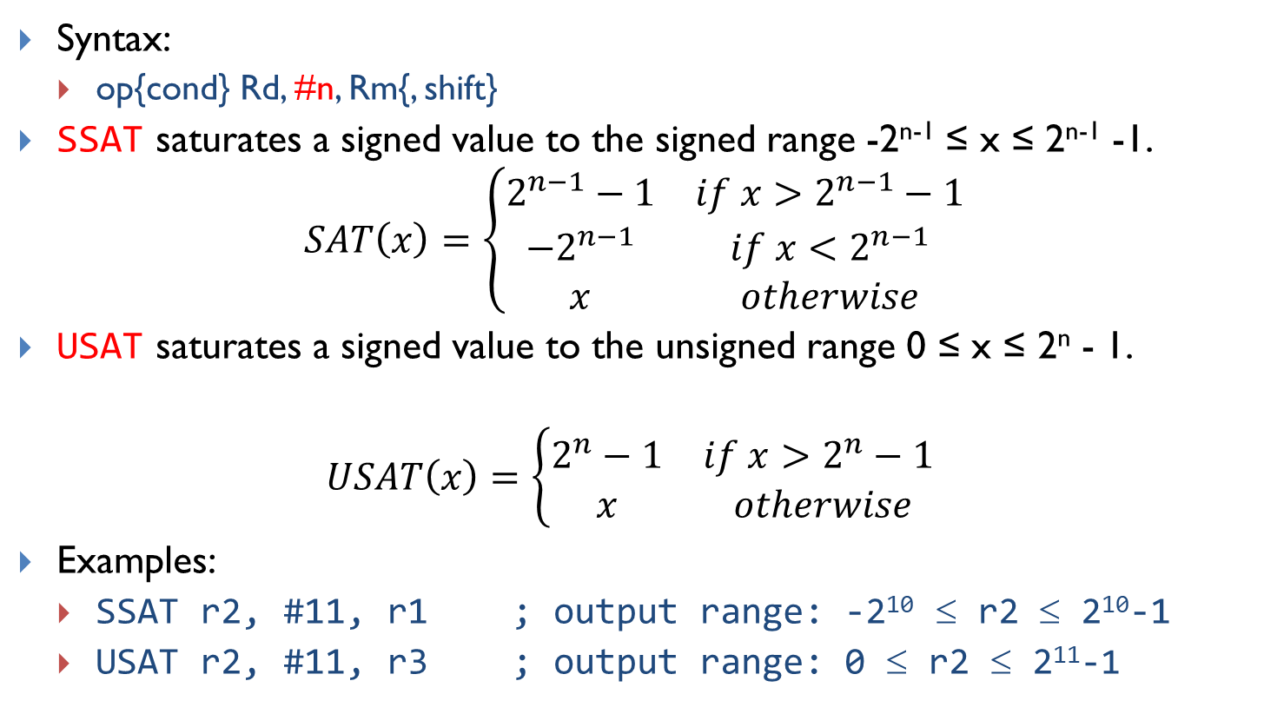
Saturating Instruction: SSAT and USAT
Syntax:
  op{cond} Rd, #n, Rm{, shift}
SSAT saturates a signed value to the signed range -2^{n-1} ≤ x ≤ 2^{n-1} -1.
$$SAT\left(x\right)=\left\{\begin{matrix}2^{n−1}−1 & if x>2^{n−1}−1 \\ −2^{n−1} & if x<−2^{n−1} \\ x & otherwise\end{matrix}\right.$$
USAT saturates a signed value to the unsigned range 0 ≤ x ≤ 2^{n} - 1.
$$USAT\left(x\right)=\left\{\begin{matrix}2^{n}−1 & if x>2^{n}−1 \\ x & otherwise\end{matrix}\right.$$
Examples:
  SSAT r2, #11, r1 ; output range: -2¹⁰ ≤ r2 ≤ 2¹⁰-1
  USAT r2, #11, r3 ; output range: 0 ≤ r2 ≤ 2¹¹-1

Slide 35
Example of Saturation
Assume data are limited to 16 bits
Without saturation
With saturation

Slide 36
Reverse Order
RBIT Rd, Rn | Reverse bit order in a word for (i = 0; i < 32; i++) Rd[i] ← RN[31– i]
REV Rd, Rn | Reverse byte order in a word Rd[31:24] ← Rn[7:0], Rd[23:16] ← Rn[15:8], Rd[15:8] ← Rn[23:16], Rd[7:0] ← Rn[31:24]
REV16 Rd, Rn | Reverse byte order in each half-word Rd[15:8] ← Rn[7:0], Rd[7:0] ← Rn[15:8], Rd[31:24] ← Rn[23:16], Rd[23:16] ← Rn[31:24]
REVSH Rd, Rn | Reverse byte order in bottom half-word and sign extend Rd[15:8] ← Rn[7:0], Rd[7:0] ← Rn[15:8], Rd[31:16] ← Rn[7] & 0xFFFF
RBIT Rd, Rn
Rn
Rd
Example:
LDR r0, =0x12345678 ; r0 = 0x12345678
RBIT r1, r0 ; Reverse bits, r1 = 0x1E6A2C48
; Note r1 != 0x87654321

Slide 37

Reverse Order
RBIT Rd, Rn | Reverse bit order in a word for (i = 0; i < 32; i++) Rd[i] ← RN[31– i]
REV Rd, Rn | Reverse byte order in a word Rd[31:24] ← Rn[7:0], Rd[23:16] ← Rn[15:8], Rd[15:8] ← Rn[23:16], Rd[7:0] ← Rn[31:24]
REV16 Rd, Rn | Reverse byte order in each half-word Rd[15:8] ← Rn[7:0], Rd[7:0] ← Rn[15:8], Rd[31:24] ← Rn[23:16], Rd[23:16] ← Rn[31:24]
REVSH Rd, Rn | Reverse byte order in bottom half-word and sign extend Rd[15:8] ← Rn[7:0], Rd[7:0] ← Rn[15:8], Rd[31:16] ← Rn[7] & 0xFFFF
REV Rd, Rn
Rn
Rd
Example:
LDR R0, =0x12345678 ; R0 = 0x12345678
REV R1, R0 ; R1 = 0x78563412
; Note r1 != 0x87654321

Slide 38

Reverse Order
RBIT Rd, Rn | Reverse bit order in a word for (i = 0; i < 32; i++) Rd[i] ← RN[31– i]
REV Rd, Rn | Reverse byte order in a word Rd[31:24] ← Rn[7:0], Rd[23:16] ← Rn[15:8], Rd[15:8] ← Rn[23:16], Rd[7:0] ← Rn[31:24]
REV16 Rd, Rn | Reverse byte order in each half-word Rd[15:8] ← Rn[7:0], Rd[7:0] ← Rn[15:8], Rd[31:24] ← Rn[23:16], Rd[23:16] ← Rn[31:24]
REVSH Rd, Rn | Reverse byte order in bottom half-word and sign extend Rd[15:8] ← Rn[7:0], Rd[7:0] ← Rn[15:8], Rd[31:16] ← Rn[7] & 0xFFFF
REV16 Rd, Rn
Rn
Rd
Example:
LDR R0, =0x12345678 ; R0 = 0x12345678
REV16 R2, R0 ; R2 = 0x34127856

Slide 39

Reverse Order
RBIT Rd, Rn | Reverse bit order in a word for (i = 0; i < 32; i++) Rd[i] ← RN[31– i]
REV Rd, Rn | Reverse byte order in a word Rd[31:24] ← Rn[7:0], Rd[23:16] ← Rn[15:8], Rd[15:8] ← Rn[23:16], Rd[7:0] ← Rn[31:24]
REV16 Rd, Rn | Reverse byte order in each half-word Rd[15:8] ← Rn[7:0], Rd[7:0] ← Rn[15:8], Rd[31:24] ← Rn[23:16], Rd[23:16] ← Rn[31:24]
REVSH Rd, Rn | Reverse byte order in bottom half-word and sign extend Rd[15:8] ← Rn[7:0], Rd[7:0] ← Rn[15:8], Rd[31:16] ← Rn[7] & 0xFFFF
REVSH Rd, Rn
Rn
Rd
Example:
LDR R0, =0x33448899 ; R0 = 0x33448899
REVSH R1, R0 ; R1 = 0xFFFF9988 (sign bit of 0x9988 (1001100110001000) is 1)
Why is 9’s sign bit 1? Isn’t 9 a positive number?
ANS: 9 is 1001, so its sign bit (MSB) is 1. It means that if we view 1001
as signed int, then it is negative (=-7). But if we view 1001 as uint, then it is 9

Slide 40
Sign and Zero Extension
int8_t a = -1; // a signed 8-bit integer, a = 0xFF
int16_t b = -2; // a signed 16-bit integer, b = 0xFFFE
int32_t c; // a signed 32-bit integer
c = a; // sign extension required, c = 0xFFFFFFFF
c = b; // sign extension required, c = 0xFFFFFFFE

Slide 41
Sign and Zero Extension
SXTB {Rd,} Rm {,ROR #n} | Sign extend a byte Rd[31:0] ← Sign Extend((Rm ROR (8 × n))[7:0])
SXTH {Rd,} Rm {,ROR #n} | Sign extend a half-word Rd[31:0] ← Sign Extend((Rm ROR (8 × n))[15:0])
UXTB {Rd,} Rm {,ROR #n} | Zero extend a byte Rd[31:0] ← Zero Extend((Rm ROR (8 × n))[7:0])
UXTH {Rd,} Rm {,ROR #n} | Zero extend a half-word Rd[31:0] ← Zero Extend((Rm ROR (8 × n))[15:0])
LDR R0, =0x55AA8765
SXTB R1, R0 ; R1 = 0x00000065
SXTH R1, R0 ; R1 = 0xFFFF8765
UXTB R1, R0 ; R1 = 0x00000065
UXTH R1, R0 ; R1 = 0x00008765
Sign extension (SX) preserves register value for signed int
Zero extension (UX) preserves register value for unsigned int
e.g., 0xFFFF8765 = 0x8765 as signed int, but 0xFFFF8765 != 0x8765 as unsigned int
0x00008765 = 0x8765 as unsigned int, but 0x00008765 != 0x8765 as signed int

Slide 42
Move Data between Registers
MOV | Rd ← operand2
MVN | Rd ← NOT operand2
MRS Rd, spec_reg | Move from special register to general register
MSR spec_reg, Rm | Move from general register to special register
MOV r4, r5 ; Copy r5 to r4
MVN r4, r5 ; r4 = bitwise logical NOT of r5
MOV r1, r2, LSL #3 ; r1 = r2 << 3
MOV r0, PC ; Copy PC (r15) to r0
MOV r1, SP ; Copy SP (r13) to r1

Slide 43
Move Immediate Number to Register
MOVW Rd, #imm16 | Move Wide, Rd ← #imm16
MOVT Rd, #imm16 | Move Top, Rd ← #imm16 << 16
MOV Rd, #const | Move, Rd ← const
Example: Load a 32-bit number into a register
MOVW r0, #0x4321 ; r0 = 0x00004321
MOVT r0, #0x8765 ; r0 = 0x87654321
Order does matter!
MOVW will zero the upper halfword
MOVT won’t zero the lower halfword
MOVT r0, #0x8765 ; r0 = 0x8765xxxx
MOVW r0, #0x4321 ; r0 = 0x00004321
Result incorrect!

Slide 44
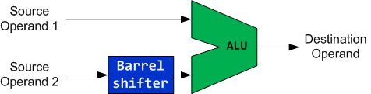
Flexible 2nd Source Operand
LSL,LSR,ASR,
ROR,RRX
ADD r0, r1, Operand2
Add r0, r1, r2 ; r0 = r1 + r2
Add r0, r1, #1 ; r0 = r1 + 1
Add r0, r1, r2, LSL #2 ; r0 = r1 + r2 << 2

Slide 45
Use Shifts To Implement Multiplication And Division
Use Barrel shifter to speed up multiplication and division
  Shifting left 1 bit <=> multiplication by 2
  Bit shifting is much more efficient than MUL instruction
Examples:
  r1 = 9 × r0 = r0 + 8 × r0
  ADD r1, r0, r0, LSL #3 <=> MOV r2, #9 ; r2 = 9
  MUL r1, r0, r2 ; r1 = r0 * 9
MUL instruction takes only registers, not an immediate, so “MUL r1, r0, #9” is invalid syntax
ADD r1, r0, r0, LSR #3
; r1 = r0 + r0 >> 3 = r0 + r0/8 (unsigned)
ADD r1, r0, r0, ASR #3
; r1 = r0 + r0 >> 3 = r0 + r0/8 (signed)
Notes:
Since multiplication is a slow operation, we can shift r0’s value left three bit positions. r0 + r0 << 3 = r0 + 8 × r0

Slide 46
Barrel Shifter
Logical Shift Left (LSL)
Arithmetic Shift Right (ASR)
Logical Shift Right (LSR)
Rotate Right (ROR)
Rotate Right Extended (RRX)
Why is there rotate right but no rotate left?
Rotate left (by n bits) can be implemented by a rotate right with by (32 – n) bits).

Slide 47
Updating APSR Flags
If “S” is present, the instruction update flags. Otherwise, the flags are not updated.
Let R be the final 32-bit result
N | Z | C | V
R<31> | IsZeroBit(R) | carry | unchanged
LSLS
ASRS
LSRS
RORS
RRXS

Slide 48
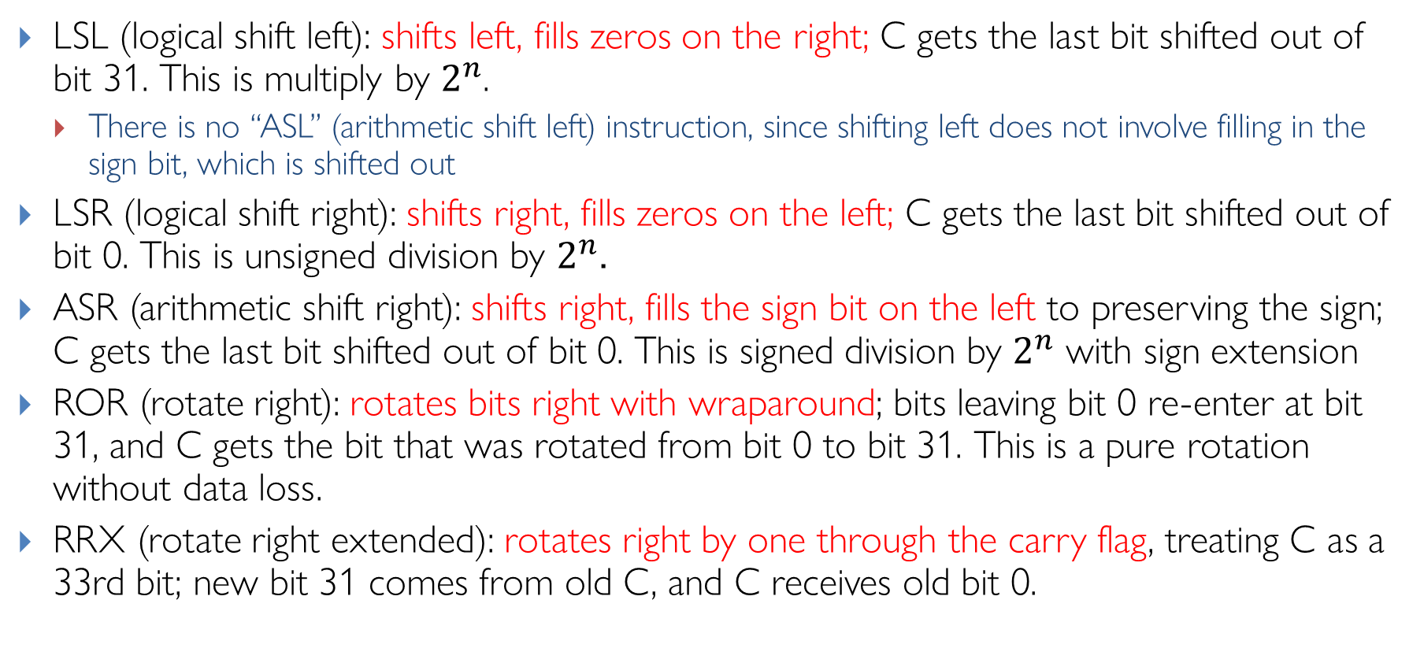
Barrel Shifter: Explanations
LSL (logical shift left): shifts left, fills zeros on the right; C gets the last bit shifted out of bit 31. This is multiply by $2^{n}$.
  There is no “ASL” (arithmetic shift left) instruction, since shifting left does not involve filling in the sign bit, which is shifted out
LSR (logical shift right): shifts right, fills zeros on the left; C gets the last bit shifted out of bit 0. This is unsigned division by $2^{n}$.
ASR (arithmetic shift right): shifts right, fills the sign bit on the left to preserving the sign; C gets the last bit shifted out of bit 0. This is signed division by $2^{n}$ with sign extension
ROR (rotate right): rotates bits right with wraparound; bits leaving bit 0 re-enter at bit 31, and C gets the bit that was rotated from bit 0 to bit 31. This is a pure rotation without data loss.
RRX (rotate right extended): rotates right by one through the carry flag, treating C as a 33rd bit; new bit 31 comes from old C, and C receives old bit 0.
Notes:
Useful for multiword shifts and certain crypto/bit-manip patterns
LSR (used here): Always fills with zeros, converting the negative value to a large positive number
ASR: Would preserve the sign bit, maintaining the negative value (-4096)
The carry flag captures the last bit shifted out of the register during shift operations, when the instruction explicitly updates flags (using S suffix like MOVS, LSLS, ASRS)
LSLS (Logical Shift Left): Carry = the last bit shifted out from the MSB position (bit 31)
LSRS (Logical Shift Right), ASRS (Arithmetic Shift Right): Carry = the last bit shifted out from the LSB position (bit 0)
RORS (Rotate Right): Carry = bit that was rotated from bit 0 to bit 31

Slide 49
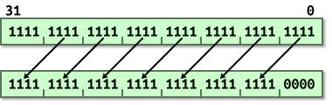
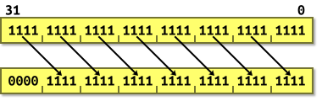
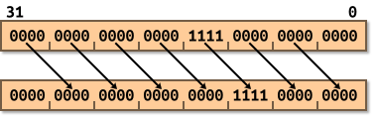
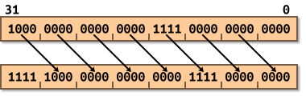
Examples (shifting by 4)
Logical Shift Left (LSL) (by 4 bits)
Logical Shift Right (LSR) (by 4 bits)
Arithmetic Shift Right (ASR) (by 4 bits)
Notes:
https://www.davespace.co.uk/arm/introduction-to-arm/barrel-shifter.html

Slide 50
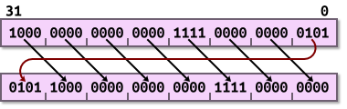
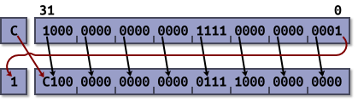
Examples (rotate)
Rotate Right (ROR) (rotate by 4)
Rotate Right Extended (RRX)
(can only rotate by 1)

Slide 51
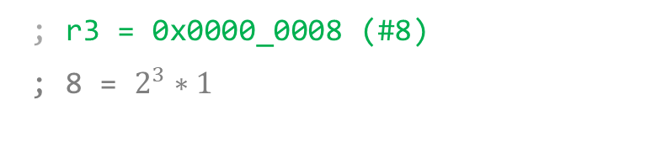
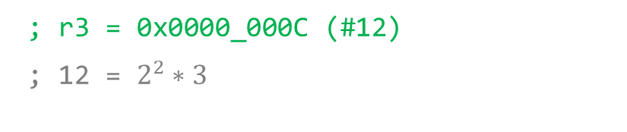
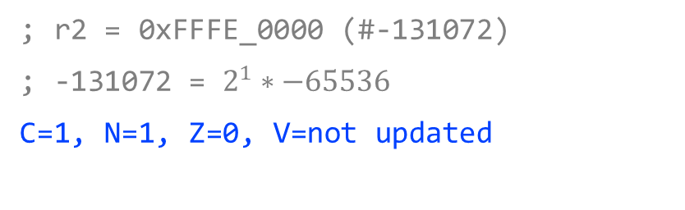
Shift Operations (showing signed ints in decimal)
Logical Shift Left (LSL)
Example 2
; r2 = 0x0000_0003 (#3)
LSL r3, r2, #2
LSL {S} Rd, Rn, <shift>
; r3 = 0x0000_000C (#12)
; 12 = $2^{2}∗3$
moves all the bits of a register by n positions to the left and inserts n zeros in the right end
0 ≤ n ≤ 31
Example 3
; r3 = 0xFFFF_0000 (#-65536)
LSLS r2, r3, #1
Example 1
; r2 = 0x0000_0001 (#1)
LSL r3, r2, #3
; r2 = 0xFFFE_0000 (#-131072)
; -131072 = $2^{1}∗−65536$
C=1, N=1, Z=0, V=not updated
; r3 = 0x0000_0008 (#8)
; 8 = $2^{3}∗1$
If S is used: C ← last bit shifted out; N ← result[31]; Z ← (result==0); V unchanged.
For LSL, we can interpret the numbers as either unsigned or signed ints. They are the same when the sign bit (MSB) is 0, but different when the sign bit is 1.

Slide 52
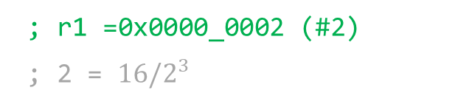
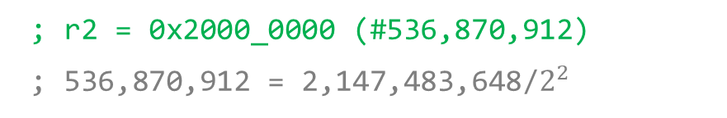
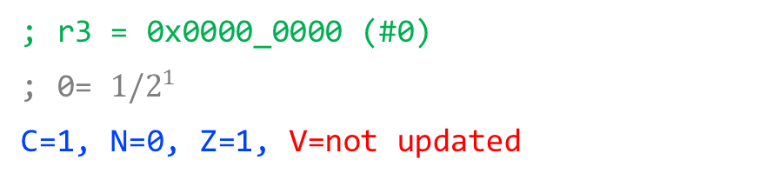
Shift Operations (showing unsigned ints in decimal)
Logical Shift Right (LSR)
Example 2
; r2 = 0x8000_0000 (#2,147,483,648)
LSR r2, r2, #2
LSR{S} Rd, Rn, <shift>
; r2 = 0x2000_0000 (#536,870,912)
; 536,870,912 = 2,147,483,648/$2^{2}$
moves all the bits of a register by n positions to the right and inserts n zeros in the left end
1 ≤ n ≤ 32
Example 3
; r2 = 0x0000_0001 (#1)
LSRS r3, r2, #1
Example 1
; r2 = 0x0000_0010 (#16)
LSR r1, r2, #3 (16(00010000) becomes 2(00000010))
; r3 = 0x0000_0000 (#0)
; 0= ${1/2}^{1}$
C=1, N=0, Z=1, V=not updated
; r1 =0x0000_0002 (#2)
; 2 = ${16/2}^{3}$
If S is used: C ← last bit shifted out on the right; N ← result[31]; Z ← (result==0); V unchanged.
For LSR, we can only interpret the numbers as unsigned ints.
Notes:
with LSR sign bit is lost (if r2 is a signed integer). So do NOT use logical shifts for signed ints!

Slide 53
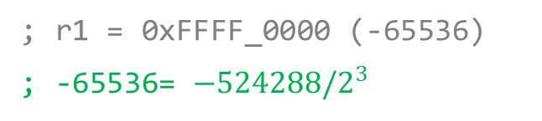
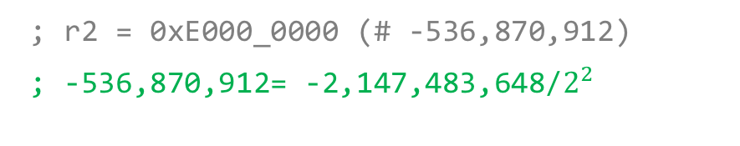
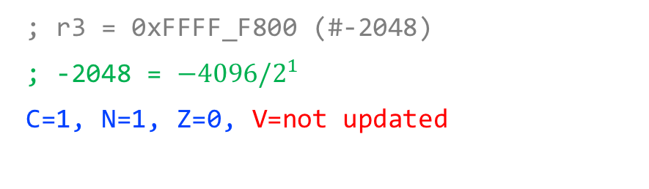
Shift Operations (showing signed ints in decimal)
Arithmetic Shift Right (ASR)
Example 2
; r2 = 0x8000_0000 (-2,147,483,648)
ASR r2, r2, #2 (8(1000) becomes E(1110))
ASR{S} Rd, Rn, <shift>
; r2 = 0xE000_0000 (# -536,870,912)
; -536,870,912= -2,147,483,648/$2^{2}$
moves all the bits of a register by n positions to the right and inserts n copies of the sign bit in the left end
1 ≤ n ≤ 32
Example 3
; r2 = 0xFFFF_F001 (#-4095)
ASRS r3, r2, #1 (0(0000) becomes 8(1000))
Example 1
; r0 = 0xFFF8_0000 (-524288)
ASR r1, r0, #3 (8(1000) becomes F(1111))
; r3 = 0xFFFF_F800 (#-2048)
; -2048 = ${−4096/2}^{1}$
C=1, N=1, Z=0, V=not updated
; r1 = 0xFFFF_0000 (-65536)
; -65536= ${−524288/2}^{3}$
If S is used: C ← last bit shifted out on the right; N ← result[31]; Z ← (result==0); V unchanged.
For ASR, we can only interpret the numbers as signed ints.
Notes:
ASR is equivalent to signed integer division
Note: ASR replicates the sign bit; for negative two’s-complement values this corresponds to division by 2^n rounded toward −∞ (floor), not toward zero.

Slide 54
Rotate Operations
Rotate Right (ROR)
Example 2: rotate left by 12 bits
; r0 = 0xF000_0000
ROR r2, r0, #20 (ROR by 20 bits, F moves to the right by 5 positions)
ROR{S} Rd, Rn, <shift>
; r2 = 0x0000_0F00
Rotate left by m (12) bits is equivalent to rotate right ROR by 32 – m = 20 bits
Circular shifts of all the bits of a register by n positions to the right as if the right end of the register is joined with its left end. The last shifted bit updates the carry bit
1 ≤ n ≤ 31
Example 3
;r2 = 0xF0F0_F001 (binary: 1111 0000 1111 0000 1111 0000 0000 0001)
;r1 = 0x0000_000E (rotate right by 14 bits)
RORS r3, r2, r1 (ROR by 14 bits)
Example 1
; r2 = 0x0008_0000
ROR r2, r2, #10 (ROR by 4 bits, 8 moves to the right by one position; ROR by 2 bits, 8 becomes 2)
; r3 = 0xC007_C3C3 (binary: 1100 0000 0000 0111 1100 0011 1100 0011)
C=1, N=1, Z=0, V=not updated
; r2 = 0x0000_0200
If S is used: C ← last bit shifted out on the right; N ← result[31]; Z ← (result==0); V unchanged.

Slide 55
Rotate Operations
Rotate Right Extended (RRX)
Example 2:
; r2 = 0xF000_0001, c = 0
RRX r1, r2
RRX{S} Rd, Rn
; r1 = 0x7800_0000, c = 1
This is a one-bit rotate instruction.
Example 3
; r2 = 0xF0F0_F001, c = 0
RRXS r3,r2
Example 1
; r2 = 0x0008_0003, c = 1
RRX r2, r2
; r3 = 0x7878_7800, c = 1
; r2 = 0x8004_0001, c = 1
C=1, N=0, Z=0, V= not updated
If S is used: C ← last bit shifted out on the right; N ← result[31]; Z ← (result==0); V unchanged.
Notes:
Note: the carry flag is updated by b0 only if the suffix S is used, otherwise it keeps its original value

Slide 56
Barrel Shifter More Examples
MOV r0, r0, LSL #1
  r0 = r0 * 2
MOV r1, r1, LSR #2
  r1 = r1 / 4 (unsigned)
MOV r2, r2, ASR #2
  r2 = r2 / 4 (signed)
MOV r3, r3, ROR #16
  Swap the top and bottom half words (16 bits) of r3.
ADD r4, r4, r4, LSL #4
  r4 = r4 * 17 (= r4 + r4 * 16)
RSB r5, r5, r5, LSL #5
  r5 = r5 * 31 (= r5 * 32 – r5)
  Reverse-subtract using barrel shifter on 2nd operand
SUB r5, r5, r5, ASR #5
  r5 = r5 – (r5 / 32) (signed)
LDR r9, [r12, r8, LSL #2]
  Load a 32‑bit word into r9 from the memory address computed as r12 + (r8 * 4)
LSL,LSR,ASR,
ROR,RRX
Barrel shifter can only be applied to Operand2, hence this is NOT a valid instruction: SUB r5, r5, LSL #5, r5. That is why we need the reverse subtraction operation RSB r5, r5, r5, LSL #5
Notes:
Subtract using barrel shifter on 2nd operand, giving r5 − (r5 >> n)
RSB r5, r5, r5, LSL #5 computes a reverse-subtract using the barrel shifter on the second operand, giving r5 = (r5 << 5) − r5.
RSB is “Reverse SuBtract”: result = Operand2 − Rn, not Rn − Operand2.
Here, Rn is r5, and Operand2 is r5 logically shifted left by 5 bits.
Thus Operand2 = r5 × 2^5 = 32·r5, so the operation is r5 = 32·r5 − r5 = 31·r5.
No flags are updated because there is no S suffix.
Intuition and uses
It’s a strength-reduction trick: multiply by 31 using one instruction by combining a shift and a subtract in the ALU’s flexible operand path.
Equivalent sequences:
SUB r5, r5, r5, LSR #? is different; SUB would compute r5 − (r5 >> n).
RSB r5, r5, r5, LSL #k generally yields r5 = (2^k − 1)·r5. For k=5, multiplier is 31.
https://developer.arm.com/documentation/ddi0597/latest/Base-Instructions/RSB--RSBS--register---Reverse-Subtract--register--
https://developer.arm.com/documentation/dui0231/latest/arm-instruction-reference/arm-general-data-processing-instructions/add--sub--rsb--adc--sbc--and-rsc
https://stackoverflow.com/questions/42042832/what-does-this-rsb-instruction-do-with-an-extra-lsl-1-operand
https://www.csie.ntu.edu.tw/~cyy/courses/assembly/12fall/lectures/handouts/lec09_ARMisa.pdf
https://iitd-plos.github.io/col718/ref/arm-instructionset.pdf
https://web.cs.umass.edu/~weems/homepage/335-Notes/ewExternalFiles/Lecture%2015.pdf
https://cseweb.ucsd.edu/classes/wi14/cse30-c/lectures/PI_WI_14_CSE30_lecture_8_post.pdf
https://keleshev.com/compiling-to-assembly-from-scratch/07-arm-assembly-programming
https://salmanarif.bitbucket.io/visual/supported_instructions.html

Slide 57
SUB vs. RSB
SUB instruction: SUB Rd, Rn, Operand2 performs Rd = Rn - Operand2
RSB instruction: RSB Rd, Rn, Operand2 performs Rd = Operand2 – Rn
  SUB R5, R3, #10 @ R5 = R3 - 10
  RSB R5, R3, #10 @ R5 = 10 - R3
When to use RSB?
Subtracting from constants, since constants can only appear as Operand2 in ARM instructions. For example:
  RSB R2, R4, #1 means R2 = 1 - R4
  This cannot be done with SUB without first loading the constant into a register
Negation Operations by subtracting from zero:
  RSB R0, R0, #0 effectively computes R0 = 0 - R0 = -R0
Complex Operand2 Operations
  RSB is valuable when you want to perform operations on Operand2 before subtraction, such as shifting :
  RSB R1, R2, R3, LSL #1 computes R1 = (R3 << 1) - R2
  This allows you to shift a value and then subtract from it in a single instruction
Notes:
The fundamental difference is that RSB reverses the order of the operands in the subtraction operation.
@ Negation
RSB R0, R0, #0 @ R0 = -R0
@ Subtract from constant
RSB R2, R4, #100 @ R2 = 100 - R4
@ Shift and subtract
RSB R1, R2, R3, LSL #2 @ R1 = (R3 << 2) - R2
@ Compare with SUB equivalent
SUB R5, R3, #10 @ R5 = R3 - 10
RSB R5, R3, #10 @ R5 = 10 - R3

Slide 58
Integer Array Access with LSL
To calculate the address of element array[i] of 32-bit integers, we calculate (base address of array) + i*4 for an array of words (1 word = 4 Bytes). For example:
  ADR r3, ARRAY @ load base address of ARRAY into r3 (ARRAY contains 4-byte ints)
  MOV r2, #6 @ Suppose we want to access ARRAY[6]
  MOV r4, r2, LSL #2 @ logical shift i’s value in r2 by 2 to multiply its value by 4
  ADD r5, r3, r4 @ finish calculation of the address of element array[i] in r5
  LDR r6, [r5] @ load value of array[i] into r6 using the address in r5
Alternatively, we can perform this same address calculation with a single ADD instead of 2 instructions MOV and ADD shown above:
  MOV r4, r2, LSL #2 and ADD r5, r3, r4 can be replaced by one instruction:
  ADD r5, r3, r2, LSL #2 @ calculate address of array[i] in r5 with single ADD
Alternatively, ARM has some nice addressing modes to speedup array item access:
  LDR r6, [r3, r2, LSL #2]

Slide 59
Notes on Shifts and Flags
A standalone logical shift instruction without the S suffix (e.g. LSL R0, R0, #1) does not update the condition flags NZCV. The S suffix (e.g. LSLS R0, R0, #1) makes the instruction update.
When a shift appears as part of a data-processing instruction that ends with S (e.g., ADDS), the processor first computes the shifted Operand2. During that computation, the shift logic sets the carry (C) flag to the last bit shifted out. After that, the data-processing instruction may itself update NZCV based on its arithmetic or logical result, potentially overwriting the C flag.
LSL can appear as a shift operator within another instruction, but LSLS cannot.
Examples:
  LSL R0, R0, #1 ; standalone LSL does NOT update flags
  LSLS R0, R0, #1 ; standalone LSLS updates NZCV (S suffix)
  ANDS R2, R1, R0, LSL #1 ; valid. LSL forms part of operand, ANDS updates NZCV
  ANDS R2, R1, R0, LSLS #1 ; invalid. Cannot embed 'LSLS' inside operand
Notes:
Note: LSL updates the C flag when it is used within the ANDS instruction. This is not a valid instruction: “ANDS r2, r1, r0, LSLS #1”, since LSL forms part of the second operand - it’s not a standalone instruction.
the flags are then affected only if the data-processing instruction itself updates flags (e.g. ANDS, ADDS, etc.).
ANDS R2, R1, R0, LSL #1, ADDS r2, r1, r0, LSL #1 are valid instructions.
By contrast, ANDS R2, R1, R0, LSLS #1, ADDS r2, r1, r0, LSLS #1 are invalid — LSLS is a standalone mnemonic and cannot be embedded in the second operand

Slide 60
In Detail: ANDS R2, R1, R0, LSL #1
The barrel shifter always runs first. If the main arithmetic instruction does not redefine C (like ANDS), shift’s C stays. If the main arithmetic instruction defines C (like ADDS), it overwrites shift’s C.
Step 1: Compute shifted Operand2
  R0 is shifted left by 1. During this shift, the barrel shifter sets C = the last bit shifted out (bit 31 of original R0).
Step 2: Perform AND
  R2 = R1 AND (R0 << 1)
Step 3: Update flags (because of S suffix in ANDS)
  N = bit 31 of result
  Z = result == 0
  V = unchanged (logical ops don’t touch V)
  C = the carry generated by the shift
Notes:
A logical shift embedded inside ANDS first computes shift and sets C, then ANDS may overwrite C.

Slide 61
Example 1: ANDS
LDR r0, =0xFFFFFF00
LDR r1, =0x00000001
ANDS r2, r1, r0, LSL #1
N = 0, Z = 1, C = 1, V = not updated
AND{S}<c><q> {<Rd>,} <Rn>, <Rm> {,<shift>}
r0 = 0xFFFFFF00
r1 = 0x00000001
r0, LSL #1 = 0xFFFFFE00
r2 = r1 AND (r0 << 1) = 0x00000001 AND 0xFFFFFE00 = 0x00000000
ANDS sets flags:
Z = 1 (result r2 is zero)
N = 0 (bit 31 of result r2 is 0)
C = 1 is set by shift “r0, LSL #1” to be bit 31 of r0. (LSL updates the C flag, since ANDS does not update C. )
V is unaffected by either ANDS or shift (left unchanged from its previous value)
Notes:
, logical operations don't affect overflow
Updates carry flag,
since ANDS does not update carry flag

Slide 62
Example 2: ADDS
LDR r0, =0xFFFFFF00
LDR r1, =0x00000001
ADDS r2, r1, r0, LSL #1
N = 1, Z = 0, C = 0, V = 0
ADD{S}<c><q> {<Rd>,} <Rn>, <Rm> {,<shift>}
r0 = 0xFFFFFF00
r1 = 0x00000001
r0, LSL #1 = 0xFFFFFE00
r2 = r1 + (r0 << 1) = 0x00000001 + 0xFFFFFE00 = 0xFFFFFE01
ADDS sets flags:
Z = 0 (result r2 is non-zero)
N = 1 (bit 31 of result r2 is 1)
C = 0 (there is no carry out from bit 31 for unsigned addition, when adding 0x00000001 and 0xFFFFFE00). (C = 1 is set by shift “r0, LSL #1”, but the C flag is overwritten by ADDS to be C=0.)
V = 0 (there is no overflow for signed addition, when adding 0x00000001 and 0xFFFFFE00. Recall: adding a positive (1) to a negative (0xFFFFFE00) (signed) cannot cause overflow.)
Notes:
Does NOT update carry flag,
since ADDS updates flags

Slide 63
Set a Bit in C
a |= (1 << k)
or
a = a | (1 << k)
Example: k = 5
a
a₇ | a₆ | a₅ | a₄ | a₃ | a₂ | a₁ | a₀
0 | 0 | 1 | 0 | 0 | 0 | 0 | 0
a₇ | a₆ | 1 | a₄ | a₃ | a₂ | a₁ | a₀
1 << k
a | (1 << k)
The other bits should not be affected.

Slide 64
Set a Bit in Assembly
a |= (1 << 5)
Solution 1:
MOV r4, #1 ; r4 = 1
LSL r4, r4, #5 ; r4 = 1<<5
ORR r0, r0, r4 ; r0 = r0 | 1<<5
Solution 2:
MOV r4, #1 ; r4 = 1
ORR r0, r0, r4, LSL #5 ; r0 = r0 | (1<<5)
Solution 3:
ORR r0, r0, # (1 << 5) ; r0 = r0 | (1<<5)

Slide 65
Clear a Bit in C
a &= ~(1<<k)
Example: k = 5
a
a₇ | a₆ | a₅ | a₄ | a₃ | a₂ | a₁ | a₀
1 | 1 | 0 | 1 | 1 | 1 | 1 | 1
a₇ | a₆ | 0 | a₄ | a₃ | a₂ | a₁ | a₀
~(1 << k)
a & ~(1<<k)
The other bits should not be affected.

Slide 66
Clear a Bit in Assembly
Recall:
BIC r0, r1, r2 ; Bit clear, r0 = r1 & ~r2
a &= ~(1<<5)
Solution 1:
MOV r4, #1 ; r4 = 1
LSL r4, r4, #5 ; r4 = 1<<5
MVN r4, r4 ; r4 = not (1<<5)
AND r0, r0, r4 ; r0 = r0 & not (1<<5)
Solution 2:
MOV r4, #1 ; r4 = 1
MVN r4, r4, LSL #5 ; r4 = not (1<<5)
AND r0, r0, r4 ; r0 = r0 & not (1<<5)
Solution 3:
MOV r4, #1 ; r4 = 1
BIC r0, r0, r4, LSL #5 ; r0 = r0 & not (1<<5)
Solution 4:
BIC r0, r0, # (1 << 5) ; r0 = r0 & not (1<<5)
Notes:
Here we can remove the S suffix for all instructions, unless the flags are used by later instructions.

Slide 67
Toggle a Bit in C
Without knowing the initial value, a bit can be toggled by XORing it with a “1”
a ^= 1<<k
Example: k = 5
a
a₇ | a₆ | a₅ | a₄ | a₃ | a₂ | a₁ | a₀
0 | 0 | 1 | 0 | 0 | 0 | 0 | 0
a₇ | a₆ | NOT(a₅) | a₄ | a₃ | a₂ | a₁ | a₀
1 << k
a ^ (1<<k)
m | n | m⊕n
0 | 0 | 0
0 | 1 | 1
1 | 0 | 1
1 | 1 | 0
Truth table of Exclusive OR
Notes:
A bit can be ‘toggled’ (changed) – without knowing its initial value – by XORing it with a “1”.

Slide 68
Toggle a Bit in Assembly
a ^= 1<<5
Solution:
MOV r4, #1 ; r4 = 1
EOR r0, r0, r4, LSL #5 ; r0 = r0 ^ 1<<5
Here we can use MOVS and EORS instead of MOV and EOR, if the flags are used by later instructions.
Notes:
A bit can be ‘toggled’ (changed) – without knowing its initial value – by XORing it with a “1”.

Slide 69
Mask
Bits 8-11 and bits 16-23 are masked.
All the rest bits are unmasked

Slide 70
Clear all unmasked bits
Data &= Mask;

Slide 71
Clear all masked bits
Data &= ~Mask;

Slide 72
Set all masked bits
Data |= Mask;

Slide 73
Toggle all masked bits
Data ^= Mask;

Slide 74
Carry and Overflow Flags w/ Arithmetic Instructions
Carry flag C = 1 (Borrow flag = 0) upon an unsigned addition if the answer is wrong (true result > 2^{n}-1)
Carry flag C = 0 (Borrow flag = 1) upon an unsigned subtraction if the answer is wrong (true result < 0)
Overflow flag V =1 upon a signed addition or subtraction if the answer is wrong (true result > 2^{n-1}-1 or true result < -2^{n-1})
Overflow may occur when adding 2 operands with the same sign, or subtracting 2 operands with different signs; V = 1 if Positive + Positive → Negative, or Negative + Negative → Positive.
Overflow cannot occur when adding 2 operands with different signs or when subtracting 2 operands with the same sign.
Tip: Convert subtraction to addition with Two’s complement.
 | Unsigned Addition | Unsigned Subtraction | Signed Addition or Subtraction
Carry flag | true result > 2^{n}-1 ➔ Carry flag=1 Borrow flag=0 (Result incorrect) | true result < 0 ➔ Carry flag=0 Borrow flag=1 (Result incorrect) | N/A
Overflow flag | N/A | N/A | true result > 2^{n-1}-1 or true result < -2^{n-1} Overflow flag=1 (Result incorrect)
74
Notes:
Convert subtraction to addition with Two’s complement. If two operands have same sign, and the result has opposite sign, then V = 1; else V = 0.”
V
adding two positives produce a negative, or adding two negatives produce a positive
convert subtraction to addition with Two’s complement. If two operands have same sign, and the result has opposite sign, then V = 1; for all other cases, V = 0
C is cleared upon an unsigned subtract if the answer is wrong
The carry flag (CF) is set differently for unsigned addition and subtraction:
When adding or subtracting two signed numbers in an n-bit system, an overflow occurs if the true result is larger than the maximum signed integer (i.e. $2^{n−1}−1$) or smaller than the minimum signed integer (i.e. ${−2}^{n−1}$) that can be represented
Overflow may occur when adding 2 operands with the same sign, or subtracting 2 operands with different signs, including:
adding two positive numbers
adding two negative numbers
subtracting a positive number from a negative number
subtracting a negative number from a positive number
Overflow cannot occur when adding 2 operands with different signs or when subtracting 2 operands with the same sign.
Why?
Unsigned Addition:
The carry flag is set to 1 if there is a carry out from the most significant bit (MSB) during the addition.
This means the sum exceeds the maximum value that can be represented in the given number of bits.
Example: Adding two 8-bit numbers resulting in a value greater than 255 will set CF = 1.
Unsigned Subtraction:
The carry flag acts as a borrow indicator for subtraction.
CF is cleared (set to 0) if a borrow is needed (i.e., if the minuend is less than the subtrahend).
CF is set to 1 if no borrow is needed, meaning the subtraction did not underflow.
Summary:
For unsigned addition, CF = 1 means an overflow beyond the MSB (carry out).
For unsigned subtraction, CF = 0 means a borrow (underflow), CF = 1 means no borrow.
The carry flag thus helps detect unsigned overflow or underflow conditions.
This behavior contrasts with signed arithmetic, where the overflow flag (OF) signals signed overflow, and the carry flag is generally not used.
References from teaching and documentation explain this clearly: The carry flag signals actual carry for addition and borrow for subtraction in unsigned arithmetic scenarios.

Slide 75
Example
For an 8-bit system, calculate 0x35 + 0x19, setting C and V flags
  Unsigned int range [0, 2⁸-1] = [0, 255], signed int range [-2⁷, 2⁷-1] = [-128, 127]
ANS:
  Convert to binary and perform addition as in table
  C = 0 since there is no carry-out from MSB b7
  V = 0 since Op1, Op2 and result are all positive (sign bit = 0)
  In decimal (not needed for exam):
    Unsigned addition: 53 + 25 = 78 (result correct)
    Signed addition: 53 + 25 = 78 (result correct)
0 | 1 | 1 | 0 | 0 | 0 | 1
0 | 0 | 1 | 1 | 0 | 1 | 0 | 1
0 | 0 | 0 | 1 | 1 | 0 | 0 | 1
0 | 1 | 0 | 0 | 1 | 1 | 1 | 0
Carry
Op1: 0x35
C = 0
V = 0
Op2: 0x19
Result: 0x4E

Slide 76
Example
For an 8-bit system, calculate 0x35 + 0x5B, setting C and V flags
  Unsigned int range [0, 2⁸-1] = [0, 255], signed int range [-2⁷, 2⁷-1] = [-128, 127]
ANS:
  Convert to binary and perform addition as in table
  C = 0 since there is no carry-out from MSB b7
  V = 1 since Op1, Op2 are positive, result is negative
  In decimal:
    Unsigned addition: 53 + 91 = 144 (result correct)
    Signed addition: true sum = 53 + 91 = 144 → result = -112 (result incorrect, V=1)
1 | 1 | 1 | 1 | 1 | 1 | 1
0 | 0 | 1 | 1 | 0 | 1 | 0 | 1
0 | 1 | 0 | 1 | 1 | 0 | 1 | 1
1 | 0 | 0 | 1 | 0 | 0 | 0 | 0
Carry
Op1: 0x35
C = 0
V = 1
Op2: 0x5B
Result: 0x90

Slide 77
Example: Subtraction
For an 8-bit system, calculate 0x35 - 0x2D, setting C and V flags
ANS:
  Convert to binary and perform addition as in table (another way is to perform subtraction in binary, but we do not cover it here)
    0x2D = 00101101, its negation TC(00101101) = 11010011 = 0xD3
  C = 1 since there is carry-out from MSB b7
  V = 0 since Op1 is positive, Op2 is negative, result is positive
    Overflow cannot occur when adding 2 operands with different signs
  In decimal:
    Unsigned subtraction: 53 – 45 = 8 (result correct, C=1, Borrow Flag=0)
    Signed: 53 - 45 = 8 (result correct, V=0)
1
1 | 1 | 1 | 0 | 1 | 1 | 1
0 | 0 | 1 | 1 | 0 | 1 | 0 | 1
1 | 1 | 0 | 1 | 0 | 0 | 1 | 1
0 | 0 | 0 | 0 | 1 | 0 | 0 | 0
Carry
Op1: 0x35
C = 1
V = 0
Op2: 0xD3
Result: 0x08 (drop 1 in 0x108)

Slide 78
Example: Subtraction More Details
Signed arithmetic 0x35 - 0x2D = 0x35 + TC(0x2D) = 0x35 + 0xD3, as TC(0x2D) is negation of 0x2D
  C=1, Borrow Flag=0
  Signed subtraction: 53 - 45 = 8 (result correct, V=0)
  Signed addition: 53 + (- 45) = 8 (result correct, V=0)
TC is only valid for signed ints, so 0x35 - 0x2D != 0x35 + TC(0x2D) for unsigned arithmetic, as TC(0x2D)=0xD3 is a totally different unrelated unsigned int 211
  Unsigned subtraction: 53 – 45 = 8 (result correct, C=1)
  Unsigned addition: 53 + 211 = 8 (true result 264) (result wrong, C=1)
1
1 | 1 | 1 | 0 | 1 | 1 | 1
0 | 0 | 1 | 1 | 0 | 1 | 0 | 1
1 | 1 | 0 | 1 | 0 | 0 | 1 | 1
0 | 0 | 0 | 0 | 1 | 0 | 0 | 0
C = 1
V = 0

Slide 79
Example
For an 8-bit system, calculate 0x9E - 0x2D, setting C and V flags
ANS:
  Convert to binary and perform addition as in table
    0x2D = 00101101, its negation TC(00101101) = 11010011 = 0xD3
  C = 1 since there is carry-out from MSB b7
  V = 1 since Op1, Op2 are both negative, result is positive
  In decimal:
    Unsigned subtraction: 158 − 45 = 113 (result correct, C=1, Borrow Flag=0)
    Signed subtraction: true sum = −98 − 45 = −143 → result = +113 (wrong, V=1)
1
0 | 0 | 1 | 1 | 1 | 1 | 0
1 | 0 | 0 | 1 | 1 | 1 | 1 | 0
1 | 1 | 0 | 1 | 0 | 0 | 1 | 1
0 | 1 | 1 | 1 | 0 | 0 | 0 | 1
Carry
Op1: 0x9E
C = 1
V = 1
Op2: 0xD3
Result: 0x71 (drop 1 in 0x171)
Notes:
01110001 in decimal0x62 = 01100010, its negation TC(01100010) = 10011110 = 0x9E

Slide 80
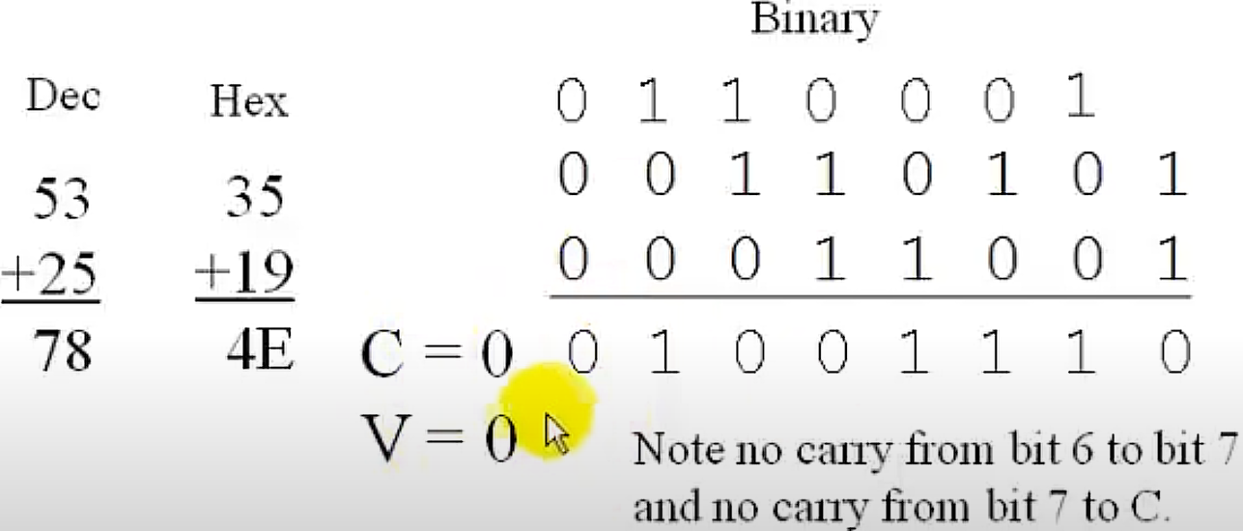
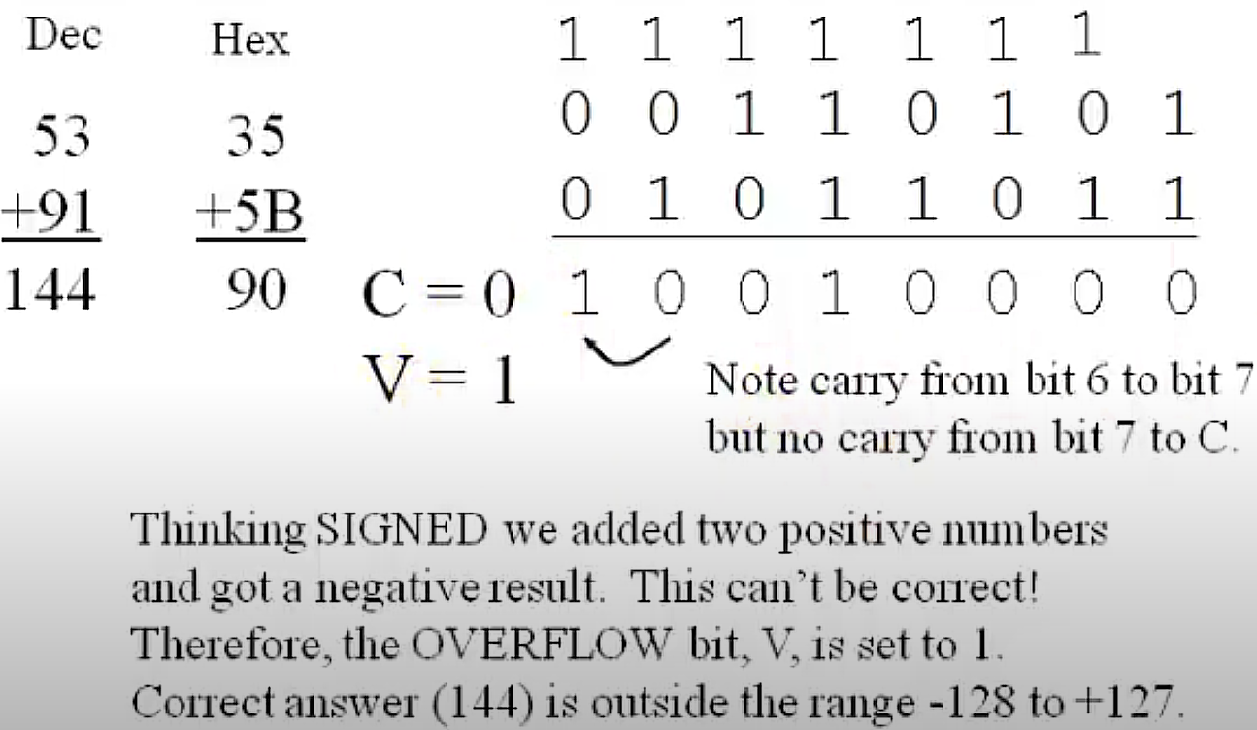
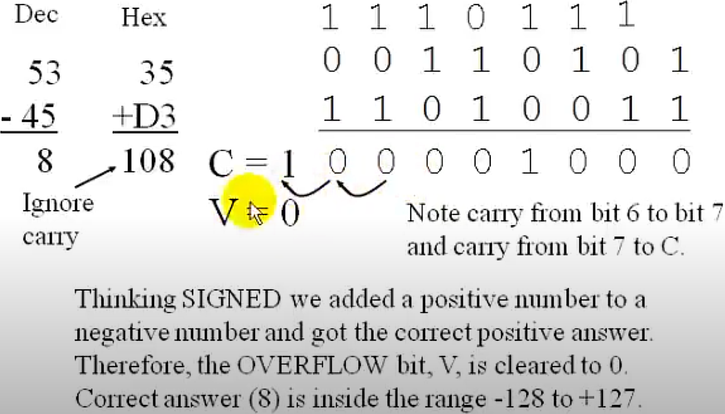
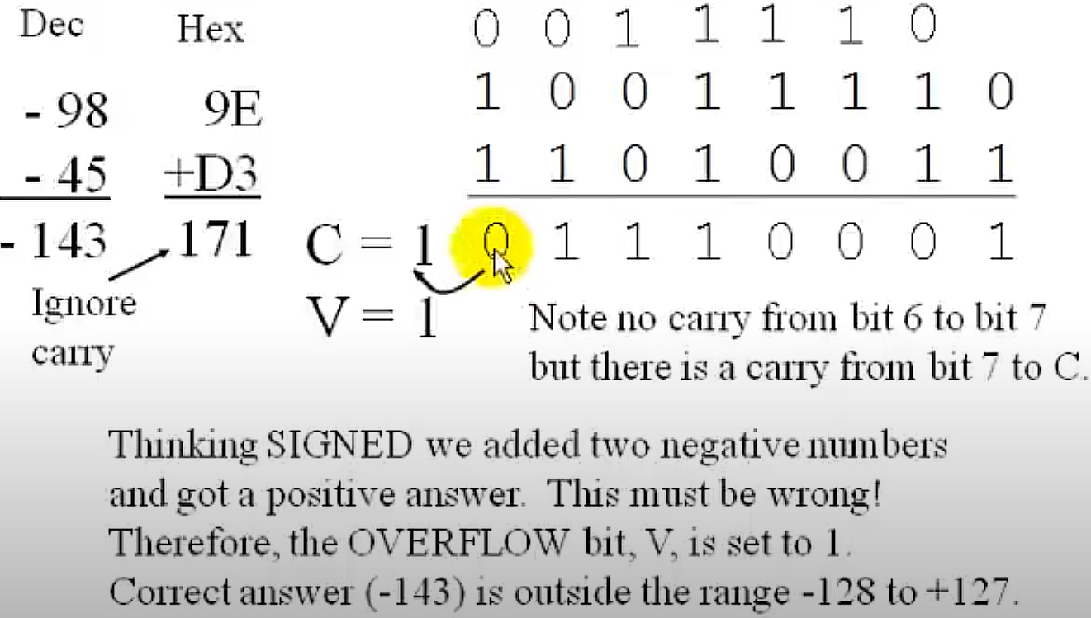
This example is only for signed arithmetic, since Op1(-98) is negative

Slide 81
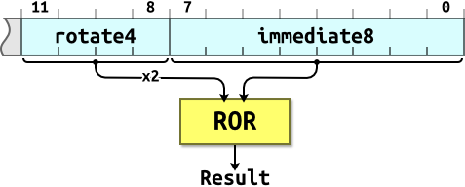
ARM Immediate Values
You can’t fit an arbitrary 32-bit value into a 32-bit instruction word. ARM data processing instructions have 12 bits of space for values in one 32-bit instruction word. This is arranged as a 4 rotate value and an 8 immediate value. The real immediate = ROR(immediate8, rotate4 × 2).
  The 4-bit rotate value stored in bits 11-8 is multiplied by two giving a range of 0-30 in steps of two.
Using this scheme we can express immediate constants such as:
  0x000000FF
  0x00000FF0 = ROR(0x000000FF, 28) ; rotate4 = 14
    Rotate left by n=4 bits can be implemented by a rotate right with by (32 – n = 28) bits.
  0xFF000000 = ROR(0x000000FF, 8) ; rotate4 = 4
  0xF000000F = ROR(0x000000FF, 4) ; rotate4 = 2
But these immediate constants are not possible:
  0x000001FE
  0xF000F000
  0x55550000
  0xFFFFFFFF
An assembler will convert big values to the rotated form. Impossible values will cause an error. For example, this instruction is invalid:
  AND R2, R0, #0xFFFFFF8F
12-bit immediate value
Notes:
https://www.davespace.co.uk/arm/introduction-to-arm/immediates.html

Slide 82
Encoding #4080 as Immediate
ADD r1, r2, #4080
  4080 = 0xFF0 in binary
You need to set values for rotate4 and immediate8 to encode #4080. The encoding is:
  immediate8 = 0x000000FF (11111111 in binary)
  rotate4 = 1110 (14*2 = 28)
ROR(0x000000FF, 28) = 0x00000FF0 (4080 in decimal)
  rotate left by 4 = rotate right by 28
Values such as #4079, #4081, #4082…cannot be encoded exactly, since no matter how you set immediate8, you only have 8 bits and you must lose some 1’s in the original number. You can use #4080 as an approximation for them
  #4079 = 111111101111
  #4081 = 111111110001
  #4082 = 111111110010
Notes:
indicates a literal, in this case the immediate value for the instruction
add 4080 to r2 and put the result in r1
▸ but only if if the CPSR flags show Z=1

Slide 83
Loading Wide Values
You can form constants wider than those available in a single instruction by using a sequence of instructions to build up the constant. For example:
  MOV r2, #0x55 ; R2 = 0x00000055
  ORR r2, r2, r2, LSL #8 ; R2 = 0x00005555
  ORR r2, r2, r2, LSL #16 ; R2 = 0x55555555
Or load the value from memory with pseudo-instruction LDR Rx,=const
  LDR r2, =0x55555555
Or use MVN instead of MOV:
  The invalid instruction MOV r0,#0xFFFFFFFF can be implemented as MVN r0,#0
Notes:
https://www.davespace.co.uk/arm/introduction-to-arm/immediates.html

Slide 84
Pseudo instruction
The ARMv7 pseudo instruction LDR r2, =0x55555555 is implemented by the assembler to load a 32-bit immediate value large constants beyond the range of the immediate field of a MOV/MVN instruction. It is translated into a PC-relative load instruction that fetches the constant from a literal pool embedded in the code:
  The assembler first tries to generate a MOV or MVN instruction if the immediate value can be encoded directly by those instructions.
  Since 0x55555555 cannot be encoded directly in a MOV or MVN, the assembler places this value in a literal pool, which is a section of memory embedded in the code to hold constant values.
  Then, the assembler generates a PC-relative LDR instruction that loads the value from the literal pool address into the specified register (r2 in this case).
  The actual machine instruction looks like LDR r2, [pc, #offset], where the offset points to the location of the 0x55555555 constant in the literal pool.
  This makes register value assignment flexible, but at the cost of incurring a memory access
(In exam questions like Q3 in the midterm, you are not allowed to use the LDR pseudo-instruction)

Slide 85
References
Lesson 45b - Adders Carry and Overflow, LBEbooks
  https://www.youtube.com/watch?v=9cXe_T99nL4
Lecture 25. Arithmetic and Logical Instructions
  https://www.youtube.com/watch?v=H-vOP2yRUj4&list=PLRJhV4hUhIymmp5CCeIFPyxbknsdcXCc8&index=25
Lecture 26. Updating NZCV bit flags
  https://www.youtube.com/watch?v=SGJibM1D2_A&list=PLRJhV4hUhIymmp5CCeIFPyxbknsdcXCc8&index=26
Notes:
ALU does not know signedness
Signedness is only about interpretation + overflow flag usage.

